Slide 1
Pipelining

Slide 2
Ways of speeding up the CPU processes
There are 2 ways to make the CPU process information faster.
  Change the internal architecture of the CPU
  Increase the working frequency

Slide 3
Change the internal architecture of the CPU
Technology dependent
  The designer must use whatever technology is available at the time with consideration for cost.
The technology and materials used in making ICs (integrated circuits) determine
  the working frequency
  Power consumption
  The number of transistors packed into a single-chip microprocessor.
Future tech – quantum processor

Slide 4
Increase the working frequency
Improve the processing power of the CPU
Method
  Pipeline
    A processor organization in which the processor consists of a number of stages, allowing multiple instructions to be executed concurrently.

Slide 5
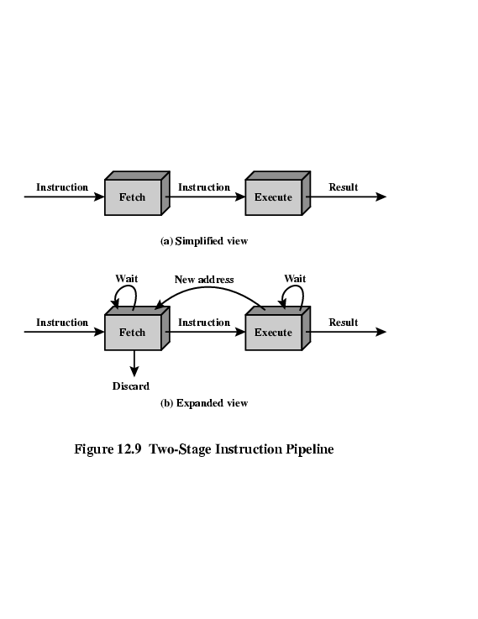
Pipeline
Intel implemented the concept of pipelining in the 8088/86 by splitting the internal structure of the microprocessor into two sections:
  execution unit (EU)
    execute instructions previously fetched
  bus interface unit (BIU)
    access the memory and peripherals (fetch instructions)
EU & BIU work simultaneously

Slide 6
Pipeline vs. Nonpipeline Execution
nonpipeline
e.g. 8085
fetch 1
exec 1
fetch 2
exec 2
fetch 3
exec 3
pipeline
e.g. 8086
fetch 1
exec 1
fetch 2
exec 2
fetch 3
exec 3

Slide 7
Pipelining - Example
Laundry Example
Allen, Boon, Calvin and David
each have one load of clothes
to wash, dry, and fold
  Washer takes 30 minutes
  Dryer takes 30 minutes
  “Folder” takes 30 minutes
  “Stasher” takes 30 minutes
  to put clothes into drawers
A
B
C
D

Slide 8
Sequential Laundry
6 PM
7
8
9
10
11
12
1
2 AM
T
a
s
k
O
r
d
e
r
30
30
30
30
30
30
30
30
30
30
30
30
30
30
30
30
Time
A
B
C
D
Sequential laundry takes 8 hours for 4 loads

Slide 9
Pipelined Laundry
6 PM
7
8
9
10
11
12
1
2 AM
30
30
30
30
30
Time
T
a
s
k
O
r
d
e
r
30
30
A
B
C
D
Pipelined laundry takes 3.5 hours for 4 loads!

Slide 10
Pipeline performance
г = max [гi] + d 1 ≤ i ≤ k
г = гm + d
гm << d
г = гm
г : cycle time of an instruction pipeline
гm : maximum stage delay/latency
d : time delay/latency of a latch (time needed to advance signals and data from one stage to the next stage)
k : number of stages in the instruction pipeline
Total time (Tk) required to execute all n instructions
(with no branch)
Tk = [k + (n - 1)] г

Slide 11
Speed up
Sk = Sequential (Time)
Pipelining (Time)
= nkг
[k+( n - 1)]г
= nk
k + (n - 1)
г
[
]г

Slide 12
Example
For sequential.
Total Time (Tk) = (k * n ) г
k = 4 stages (wash, dry, fold, Stasher)
n = 4 instructions
г = 30 minutes
Tk = (4 * 4) 30 minutes
= 480 minutes
= 8 hours

Slide 13
Example
For pipelining.
Total Time (Tk) = [k + (n - 1)] г
k = 4 stages (wash, dry, fold, Stasher)
n = 4 instructions
г = 30 minutes
Tk = [4 + (4 - 1)] 30 minutes
= 210 minutes
= 3.5 hours

Slide 14
Example
Speed up (Sk)
Sk = Sequential (Time)
Pipelining (Time)
= 8 hours
3.5 hours
=16/7

Slide 15
6 stages pipelining
Fetch instruction (FI)
Decode instruction (DI)
  Determine the opcode and the operand specifiers
Calculate operands (CO)
Fetch operands (FO)
Execute instructions (EI)
Write result (WO)
Notes:
38

Slide 16
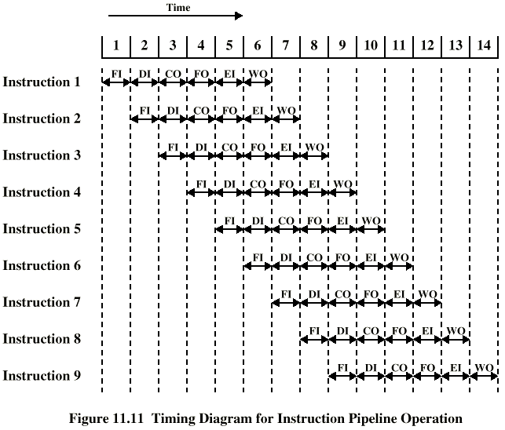
Timing of 6 stages Pipeline
Notes:
39

Slide 17
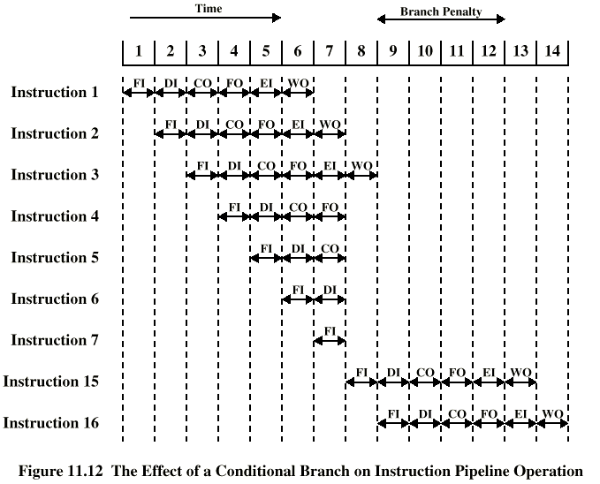
Branch in a Pipeline
Notes:
40

Slide 18
Branch in a Pipeline
Branch Penalty
  When a jump instruction is executed, the BIU starts to fetch information from the new location in memory and information in the queue that was fetched previously is discarded.
  In this situation the EU must wait until the BIU fetches the new instruction.

Slide 19
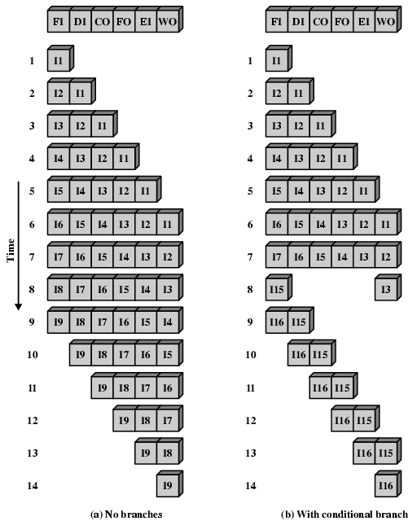
Alternative Pipeline Depiction

Slide 20
Dealing with Branches
Multiple Streams
Pre-fetch Branch Target
Loop buffer
Branch prediction
Delayed branching
Notes:
41

Slide 21
Multiple Streams
Have two pipelines
Pre-fetch each branch into a separate pipeline
Use appropriate pipeline
Leads to bus & register contention
Multiple branches lead to further pipelines being needed
Notes:
42

Slide 22
Pre-fetch Branch Target
Target of branch is prefetched in addition to instructions following branch
Keep target until branch is executed
Used by IBM 360/91
Notes:
43

Slide 23
Loop Buffer
Very fast memory
Maintained by fetch stage of pipeline
Check buffer before fetching from memory
Very good for small loops or jumps
c.f. cache
Used by CRAY-1
Notes:
44

Slide 24
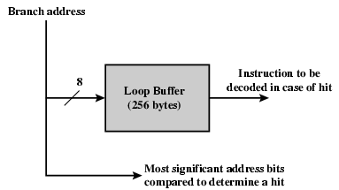
Loop Buffer Diagram

Slide 25
Branch Prediction (Static)
Predict never taken
  Assume that jump will not happen
  Always fetch next instruction
  68020 & VAX 11/780
  VAX will not pre-fetch after branch if a page fault would result (O/S v CPU design)
Predict always taken
  Assume that jump will happen
  Always fetch target instruction
Predict by Opcode
  Some instructions are more likely to result in a jump than thers
  Can get up to 75% success
Notes:
45

Slide 26
Branch Prediction (Dynamic)
Taken/Not taken switch
  Based on previous history
  Good for loops
Branch History Table
Notes:
46

Slide 27
Delayed Branch
Delayed Branch
  Do not take jump until you have to
  Rearrange instructions
Notes:
47

Slide 28
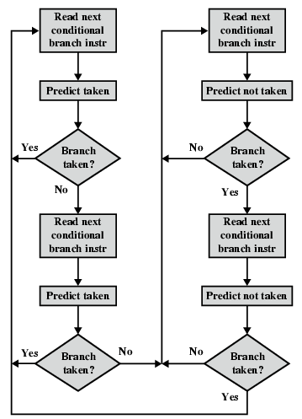
Branch Prediction Flowchart

Slide 29
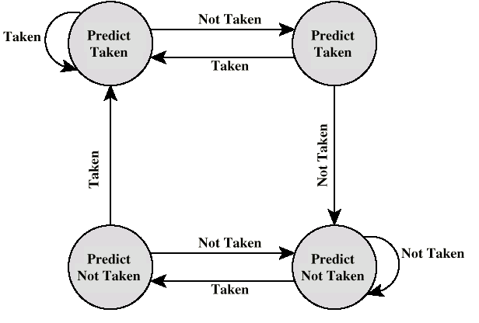
Branch Prediction State Diagram

Slide 30
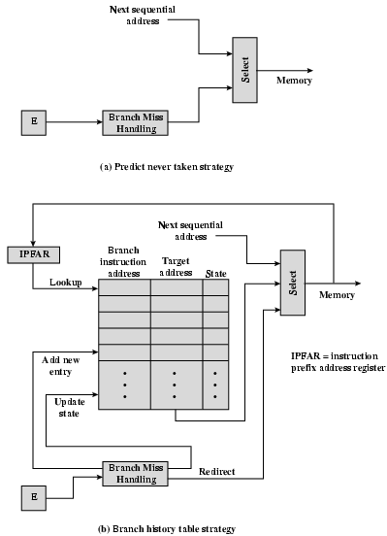
Dealing With Branches

